Slide 1
USA Tour 2018
Ramana Balachandhran

Slide 2
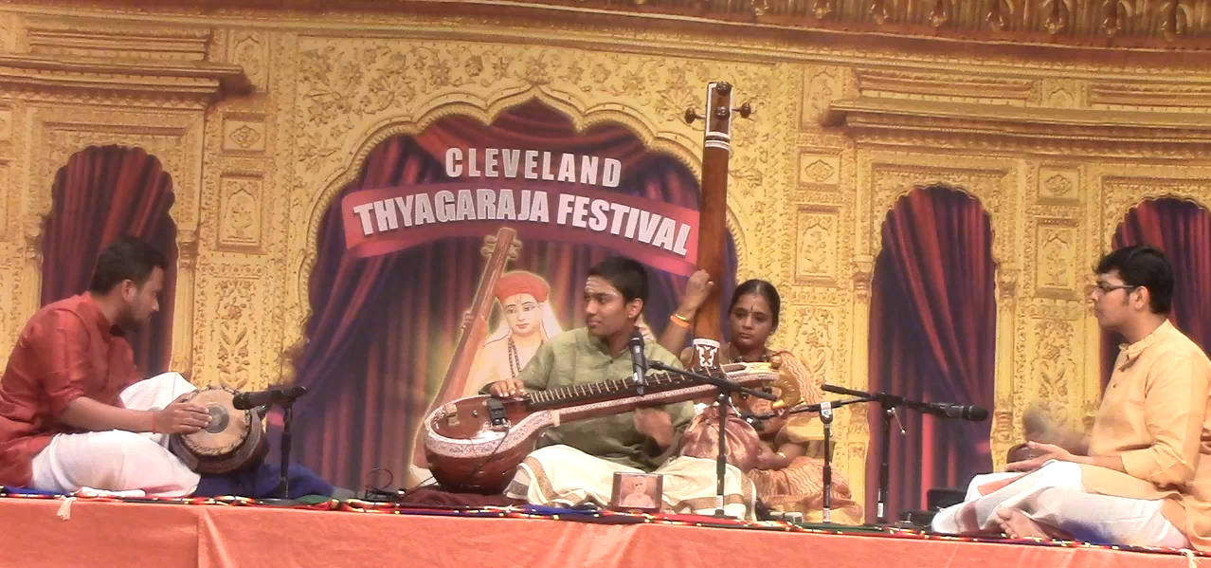
Organisation Name: Cleveland Thyagaraja Festival
Location: Cleveland
Date: 3/4/18

Slide 3
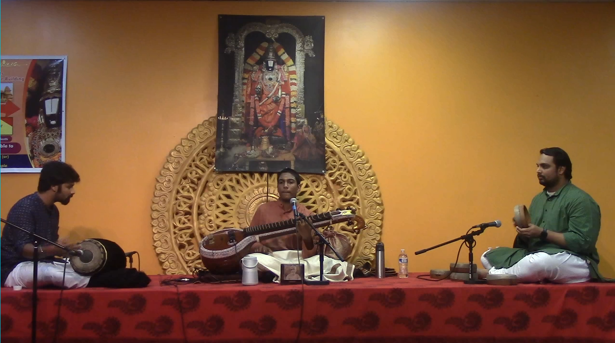
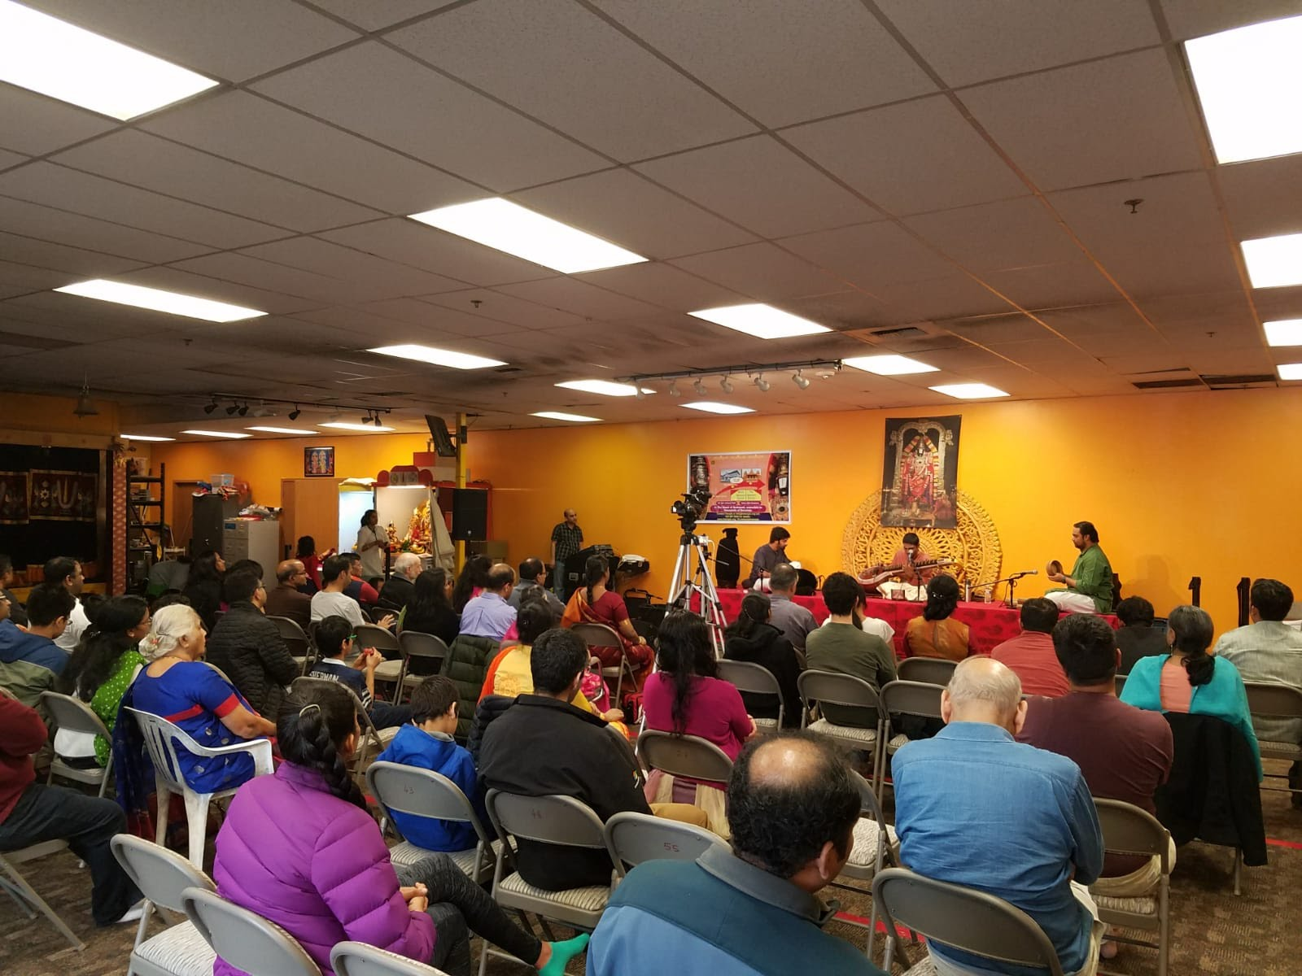
Organisation Name:
Location: Seattle
Date: 7/4/18

Slide 4
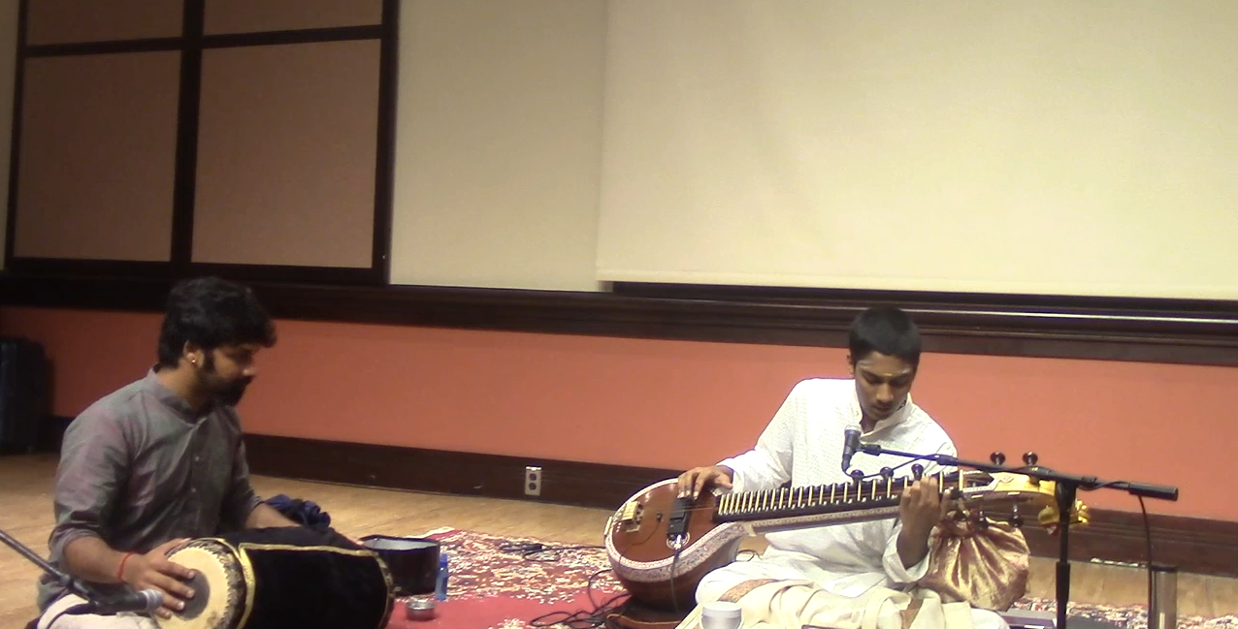
Organisation Name: MITHAS
Location: MIT, Boston
Date: 8/4/18

Slide 5
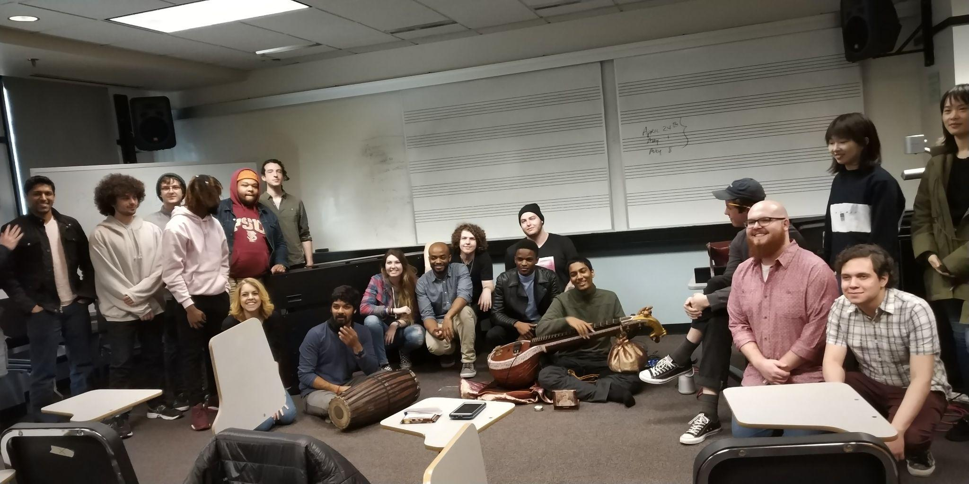
Organisation Name: Berklee College of Music
Location: Boston
Date: 9/4/18

Slide 6
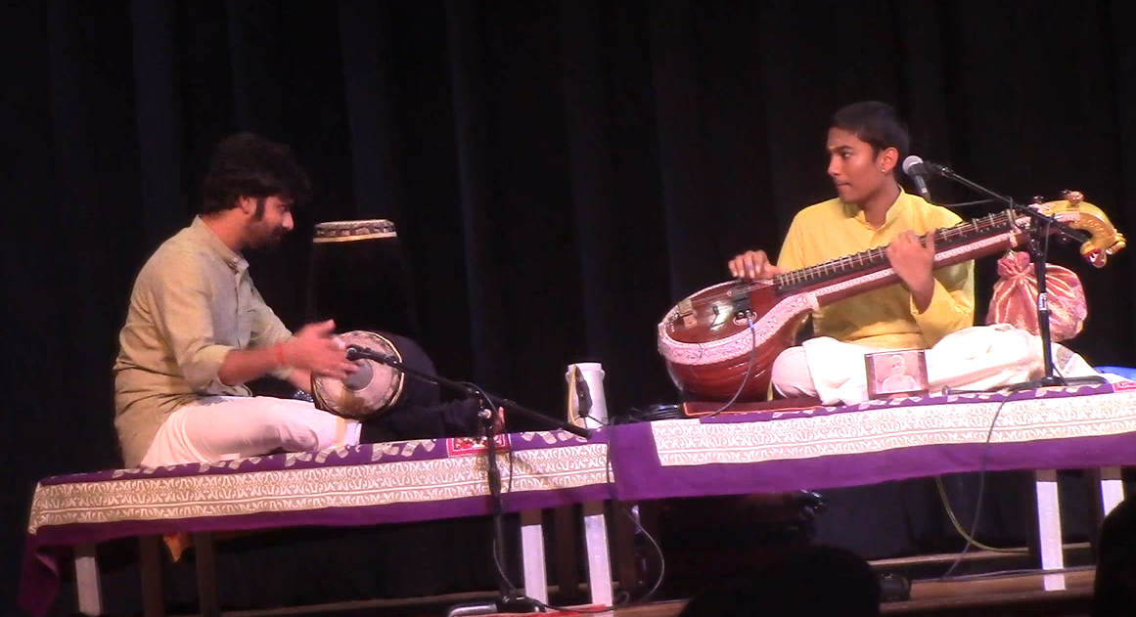
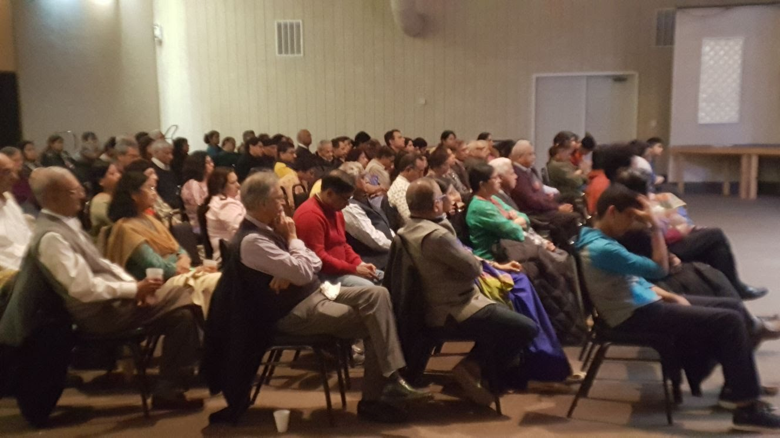
Organisation Name:
Location: Rochester
Date: 13/4/18

Slide 7
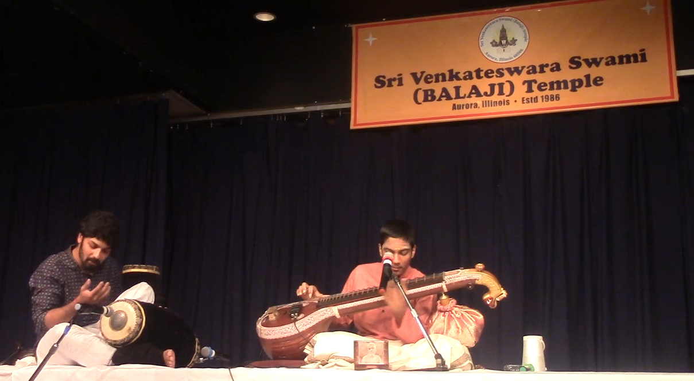
Organisation Name:
Location: Chicago
Date: 15/4/18

Slide 8
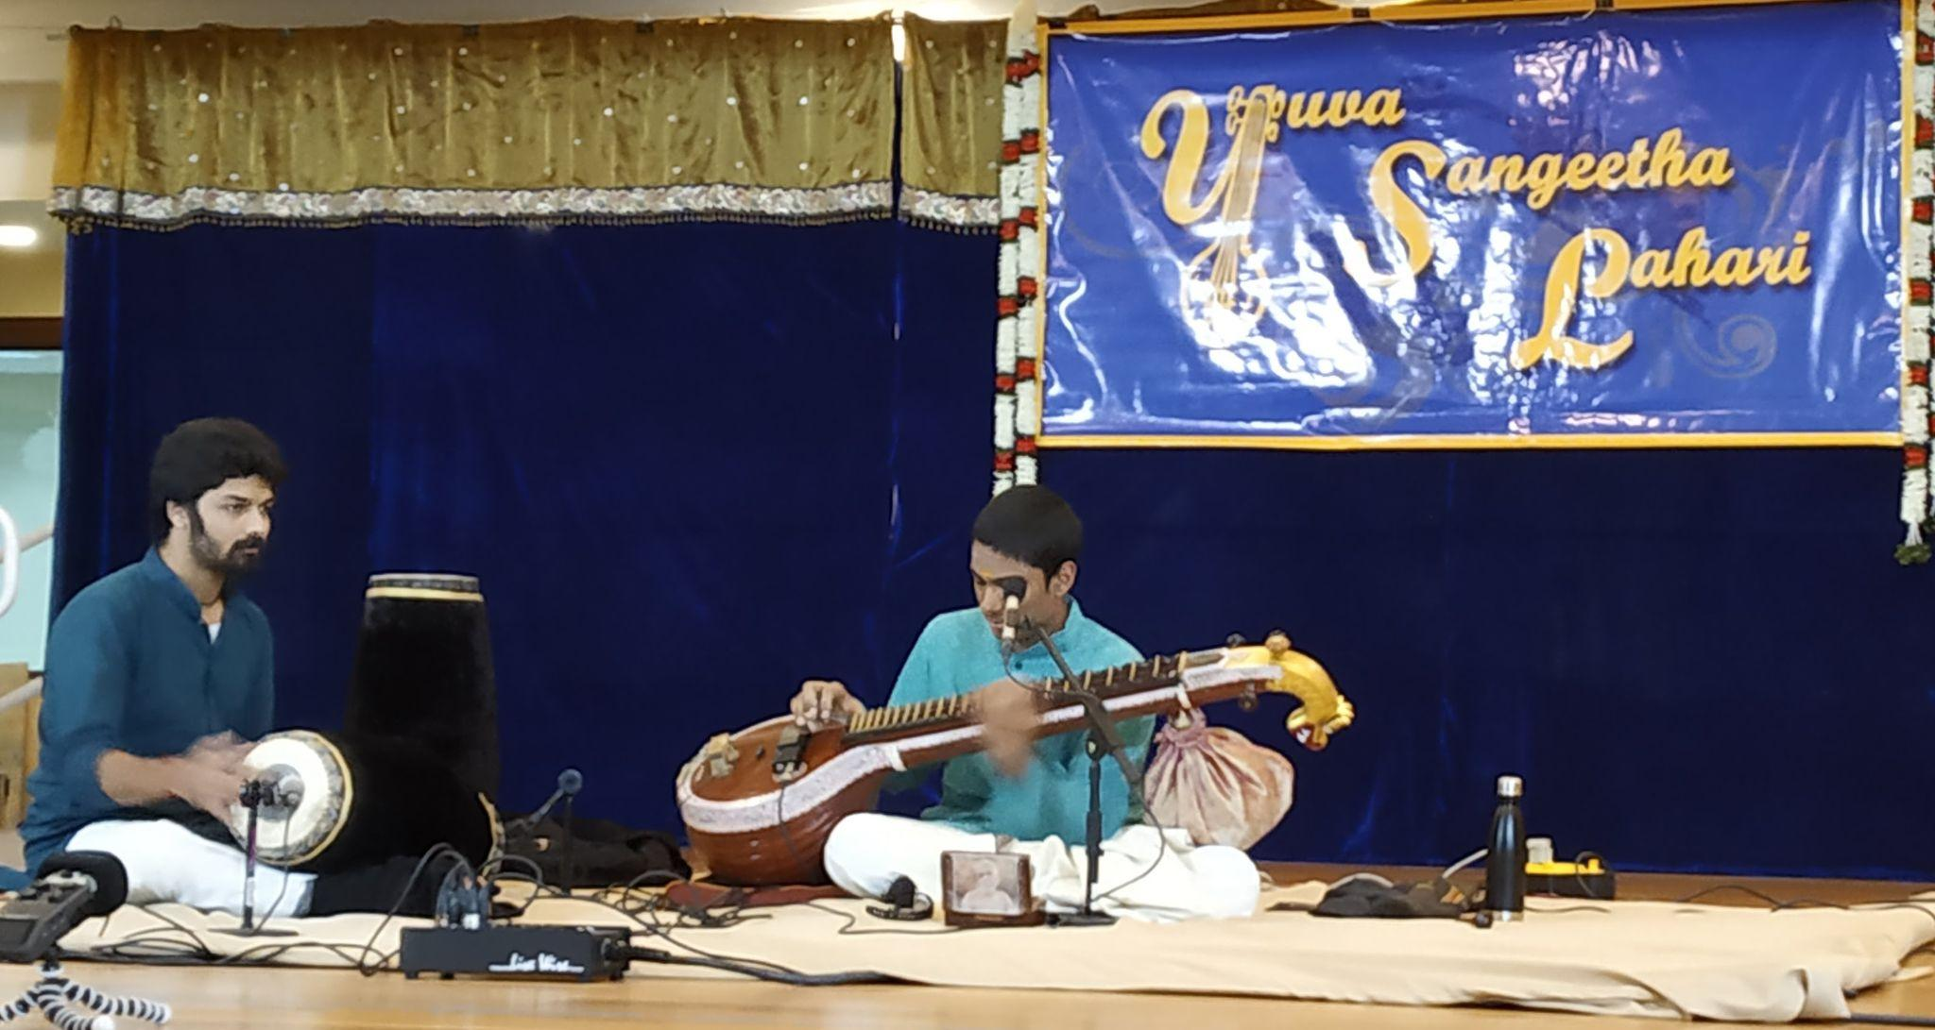
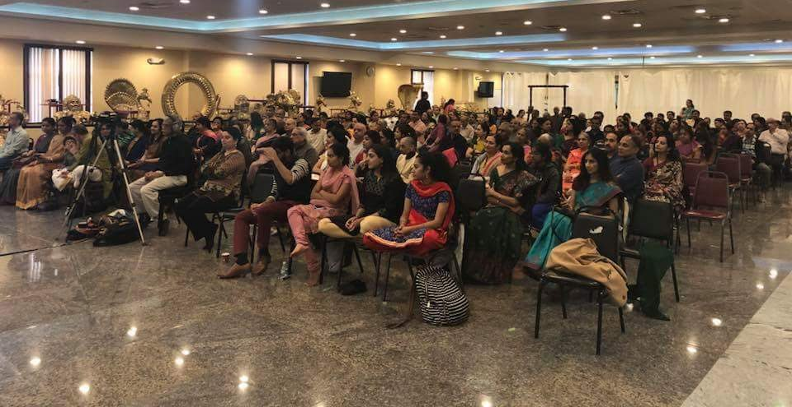
Organisation Name: YSL
Location: New Jersey
Date: 21/4/18

Slide 9
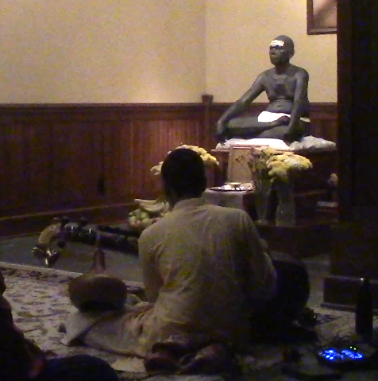
Organisation Name: Arunachala Ashrama
Location: New York
Date: 24/4/18

Slide 10
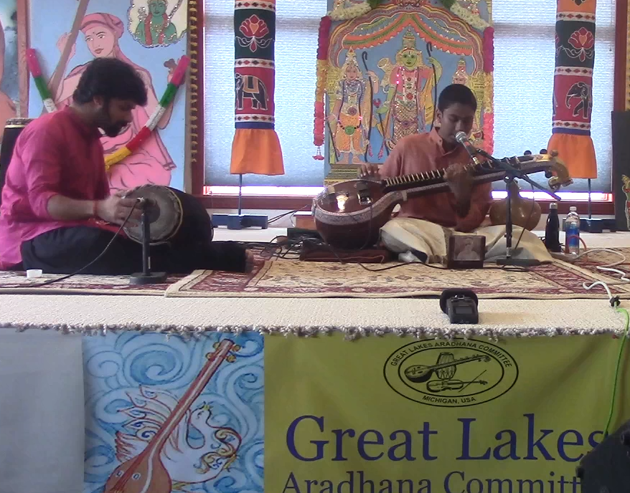
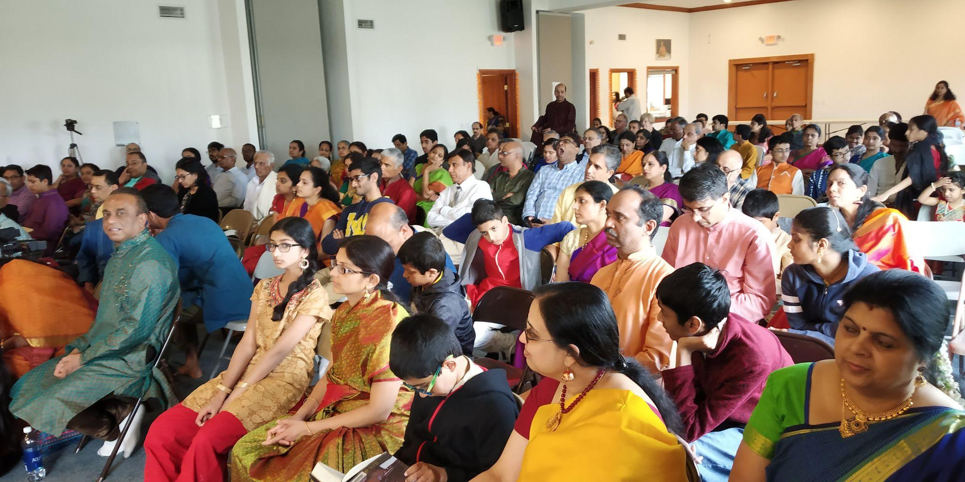
Organisation Name: GLAC
Location: Detroit
Date: 28/4/18

Slide 11
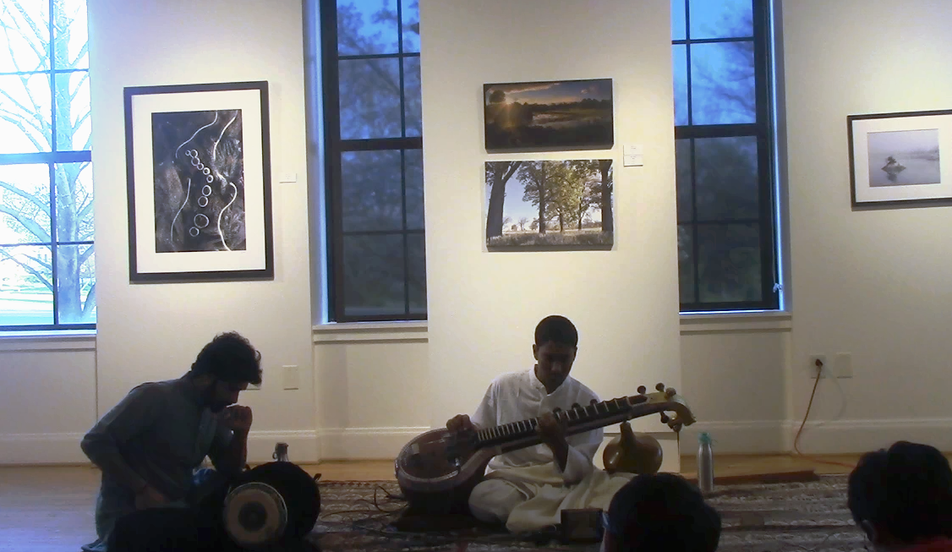
Organisation Name: Dhwani Ohio
Location: Columbus
Date: 29/4/18

Slide 12
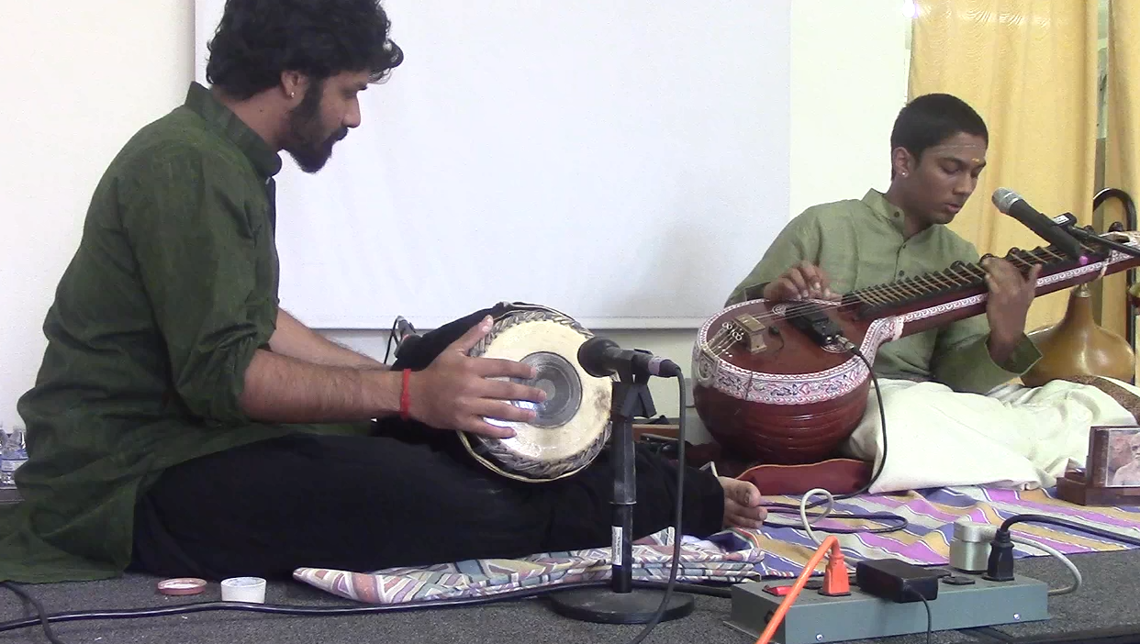
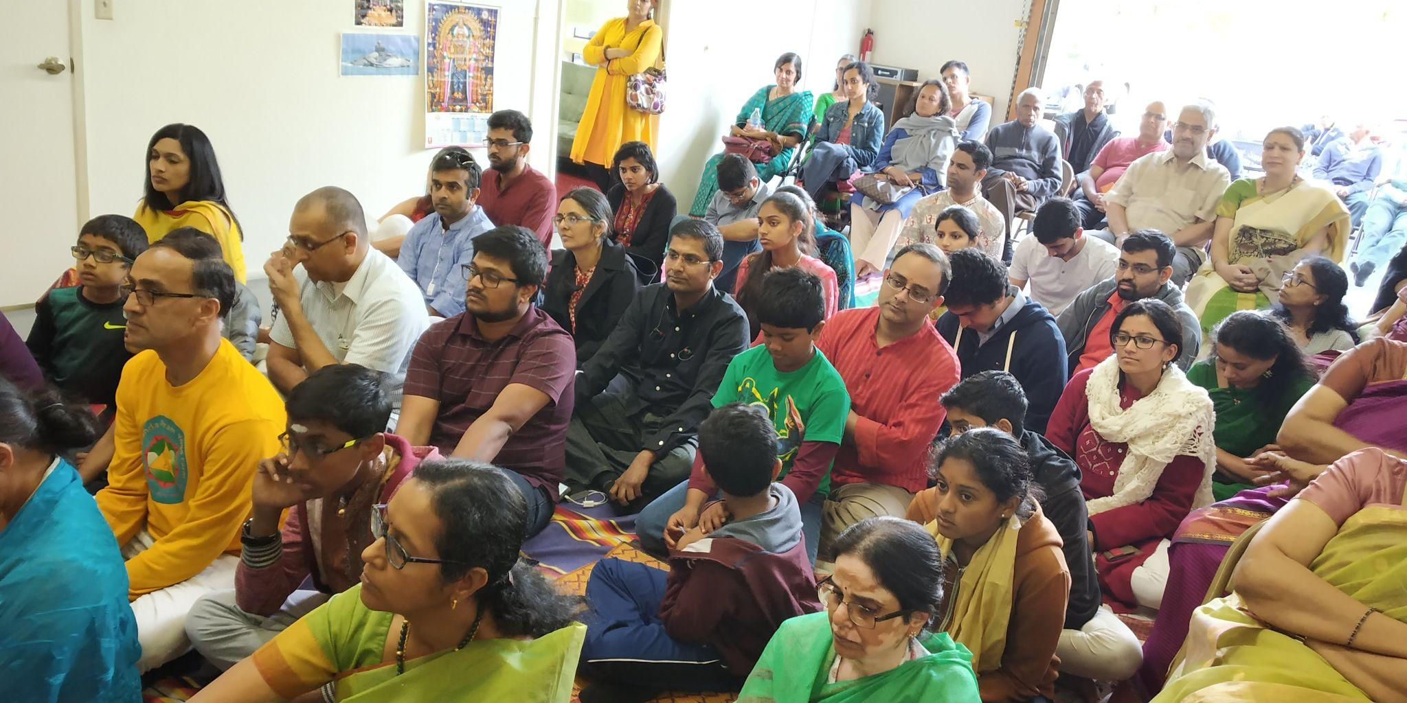
Organisation Name:
Location: San Jose
Date: 5/5/18

Slide 13
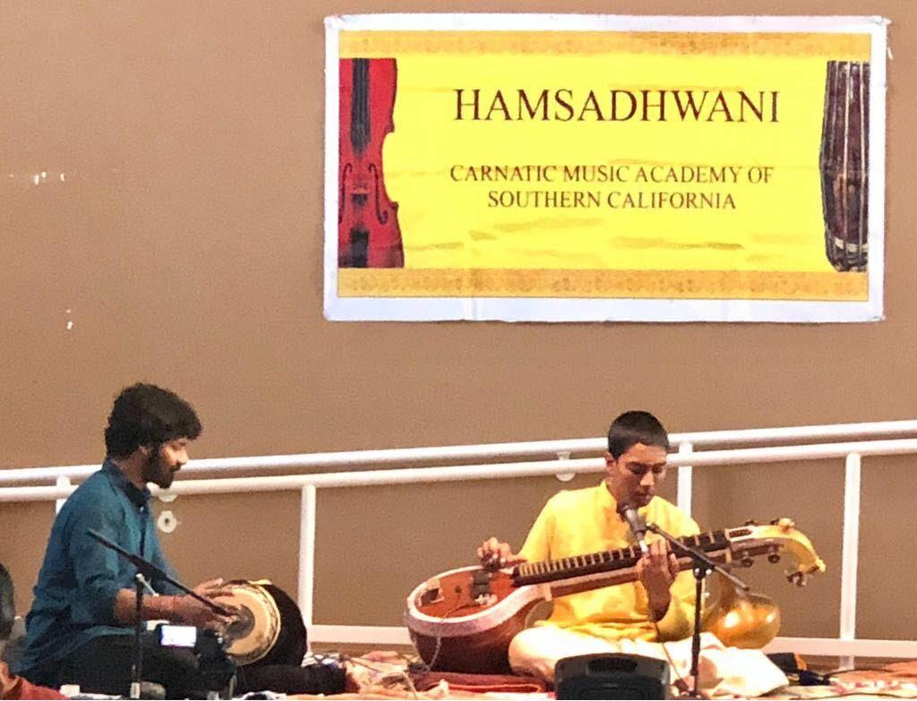
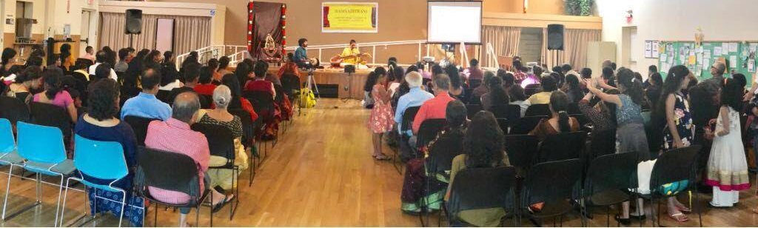
Organisation Name: Hamsadhwani
Location: Los Angeles
Date: 6/5/18

Slide 14
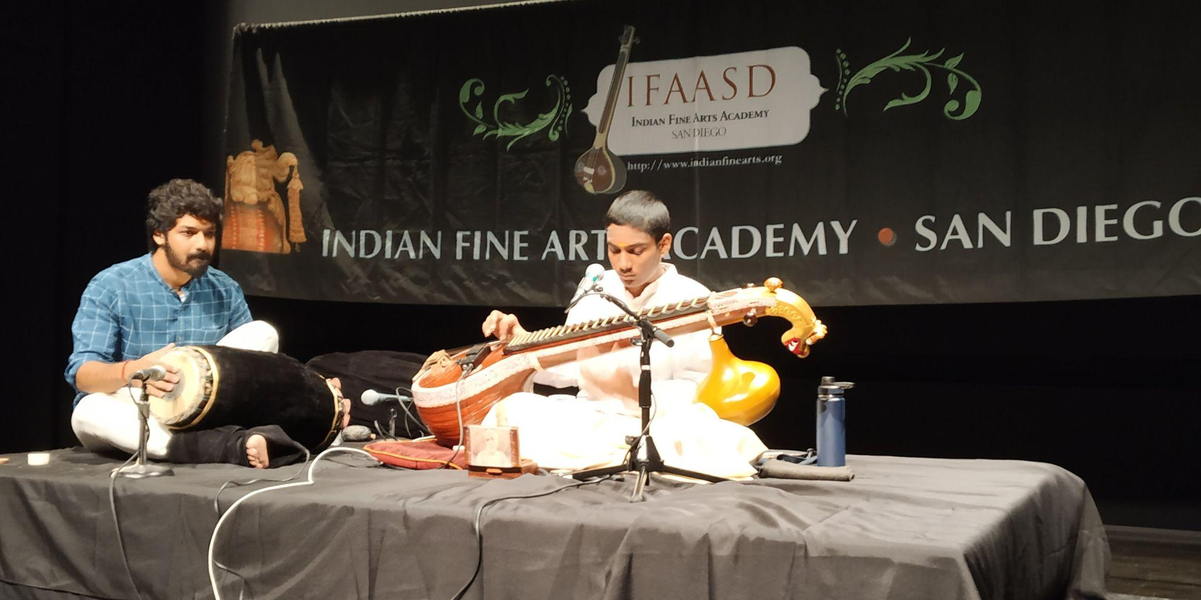
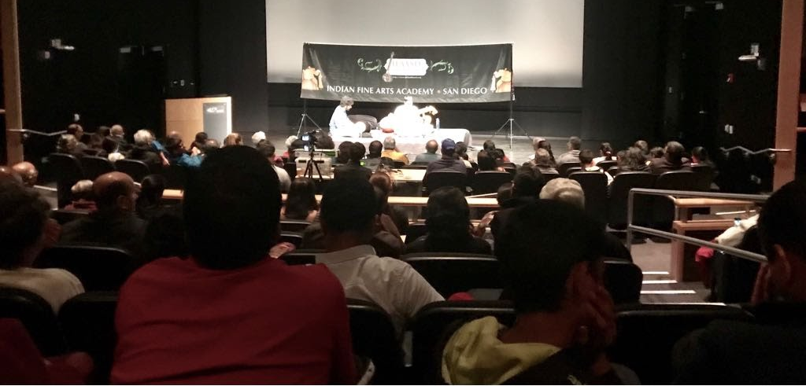
Organisation Name: IFAASD
Location: San Diego
Date: 11/5/18

Slide 15
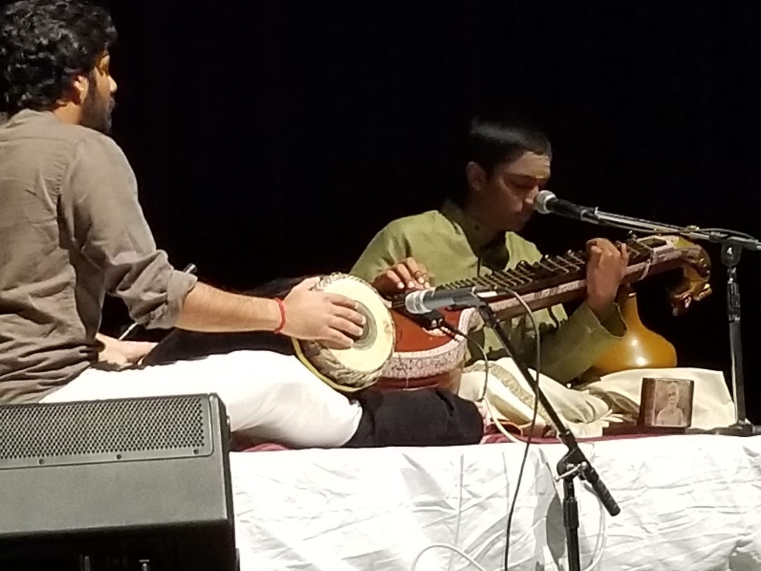
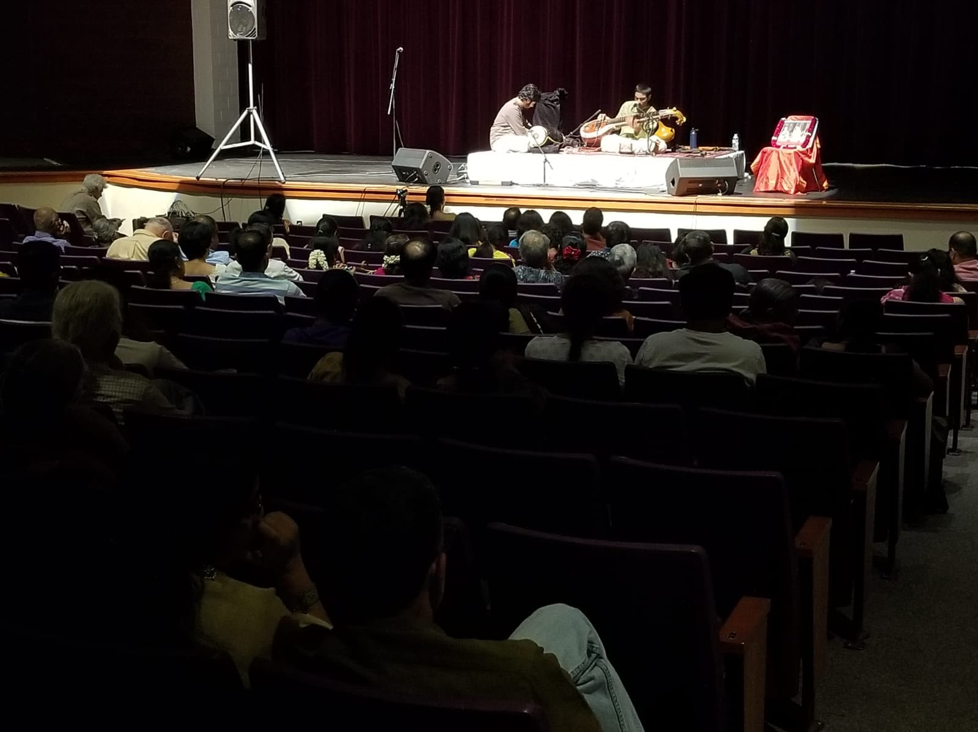
Organisation Name:
Location: Phoenix
Date: 12/5/18

Slide 16
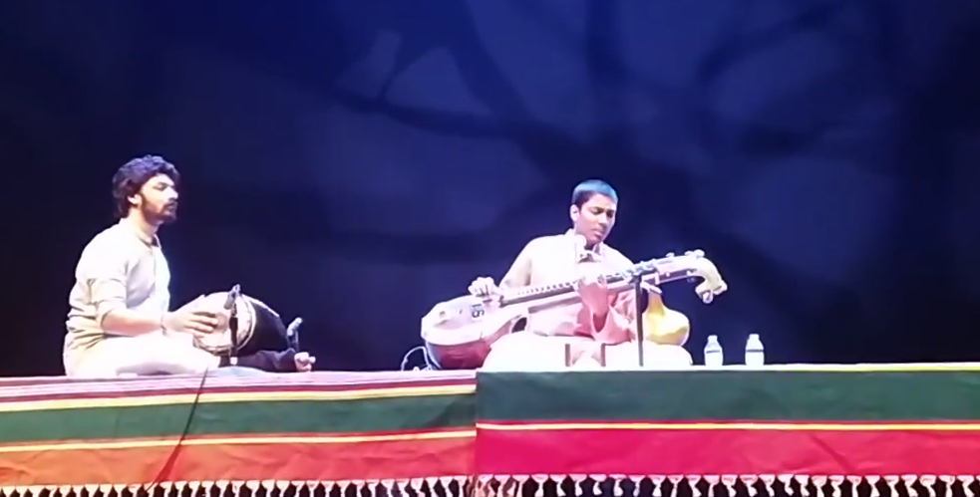
Organisation Name:
Location: Houston
Date: 13/5/18

Slide 17
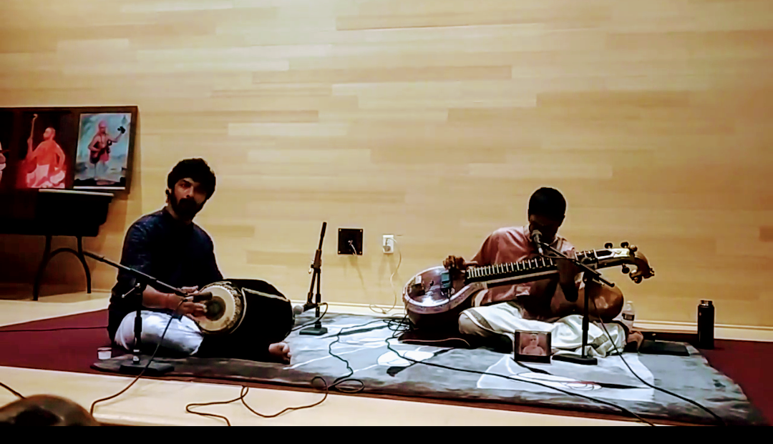
Organisation Name: JAX Raga
Location: Jacksonville
Date: 19/5/18

Slide 18
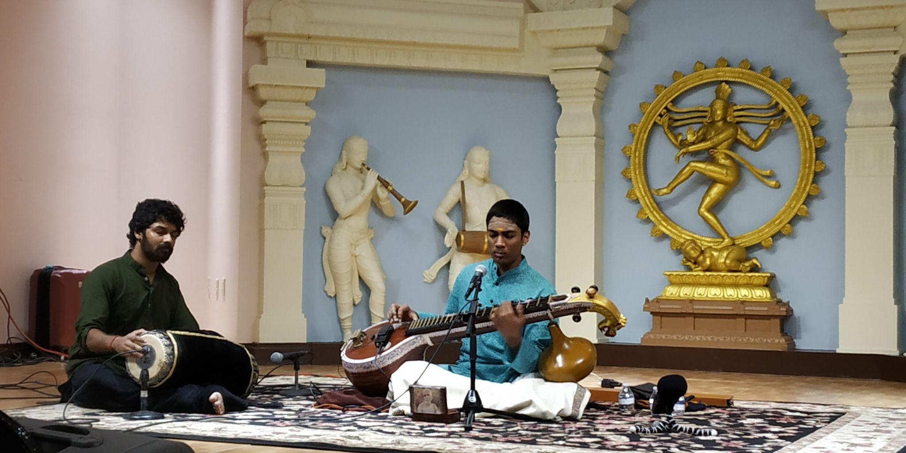
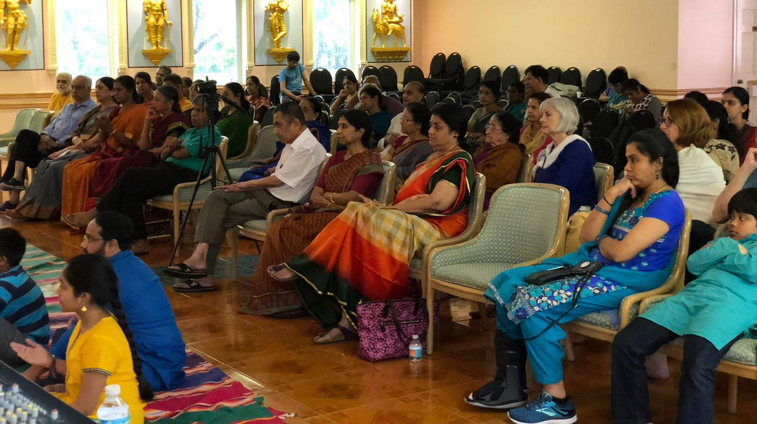
Organisation Name:
Location: Miami
Date: 20/5/18

Slide 19
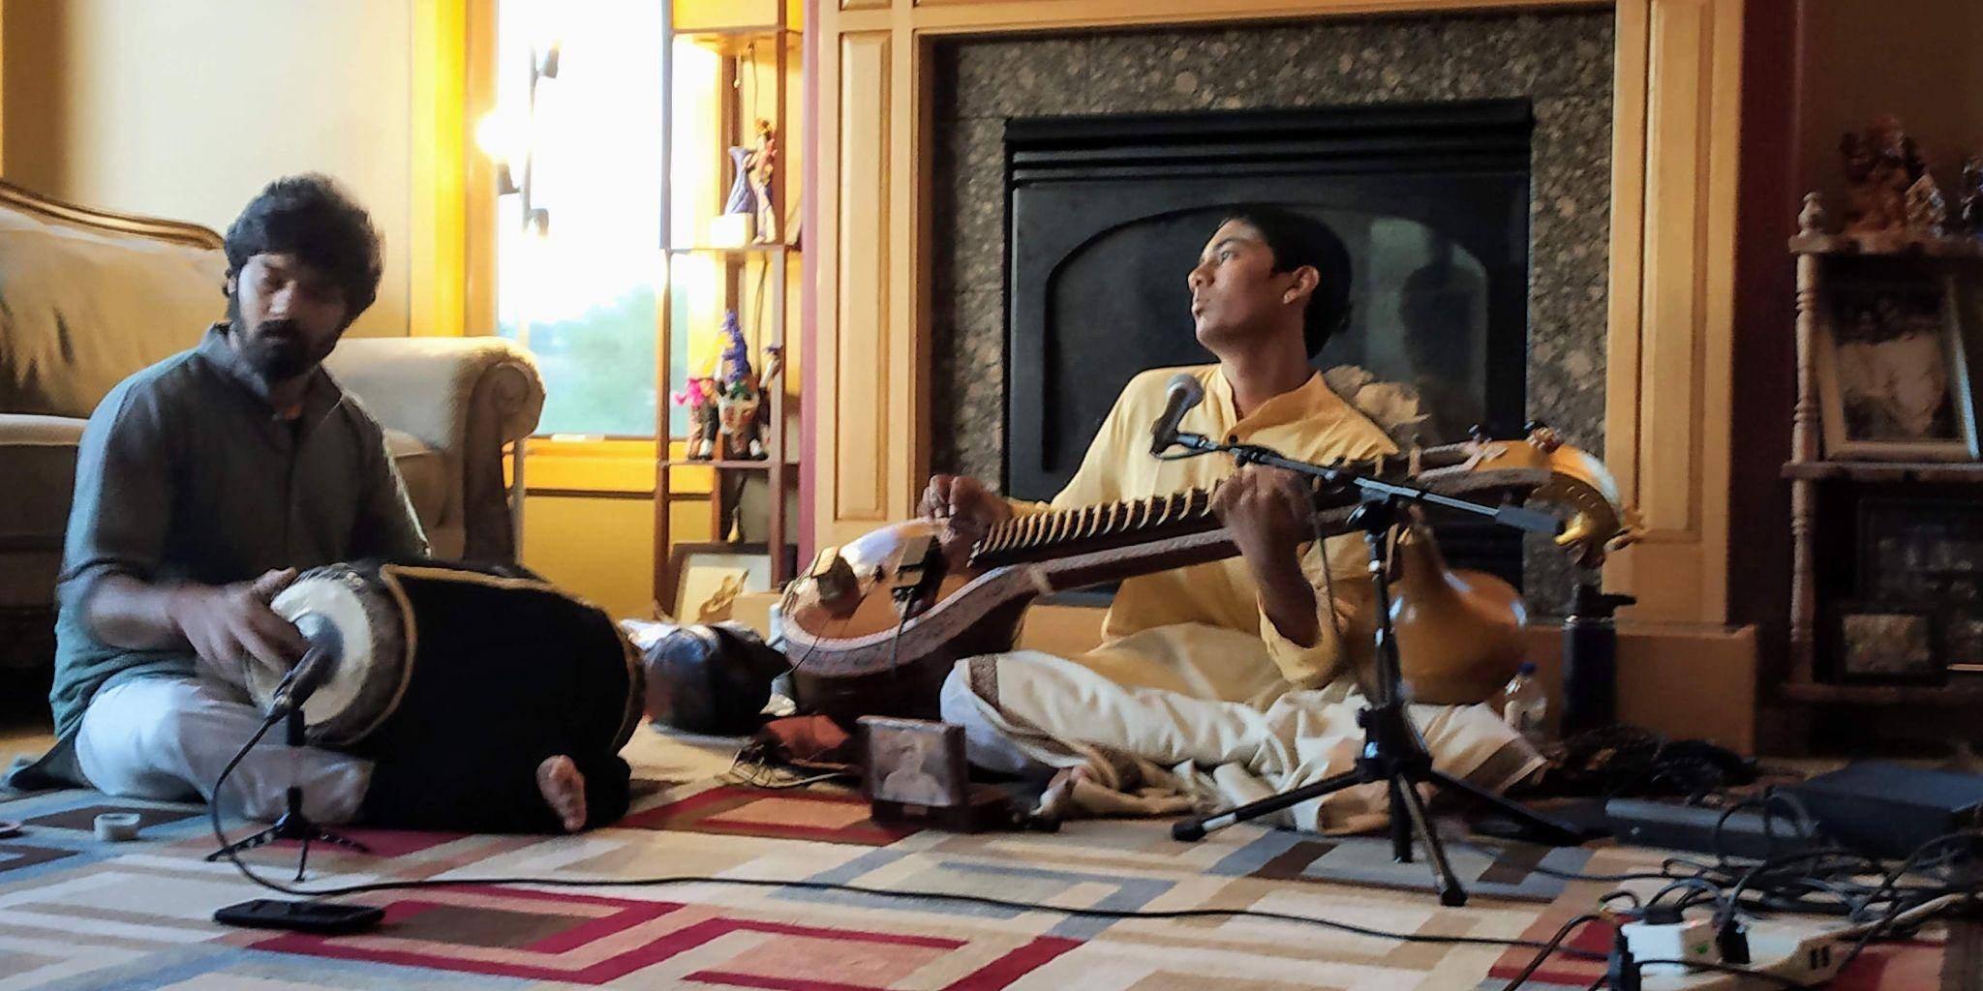
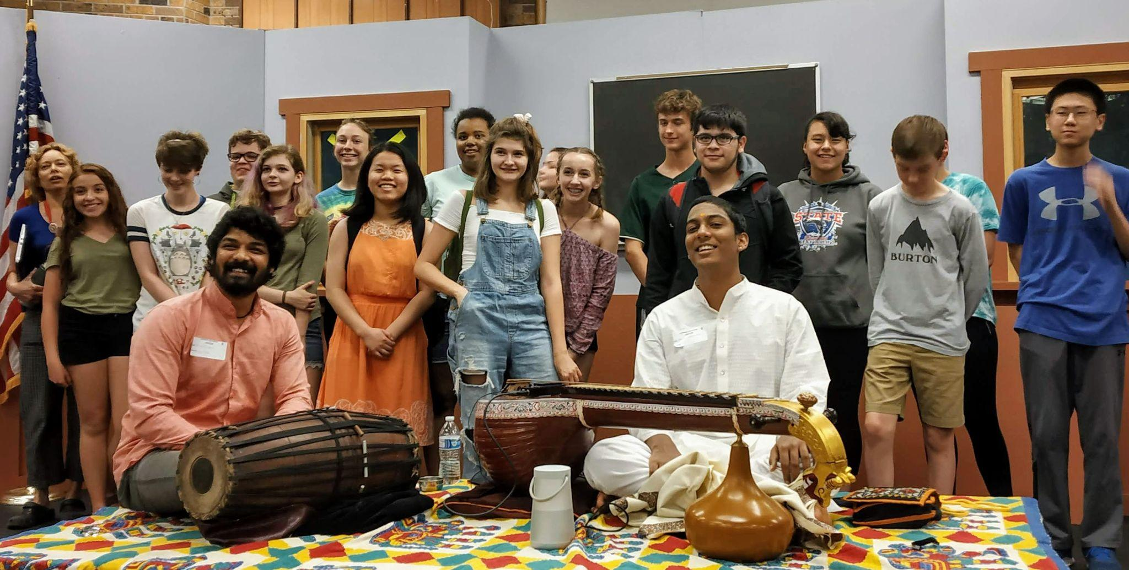
Organisation Name:
Location: Madison
Date: 24/5/18

Slide 20
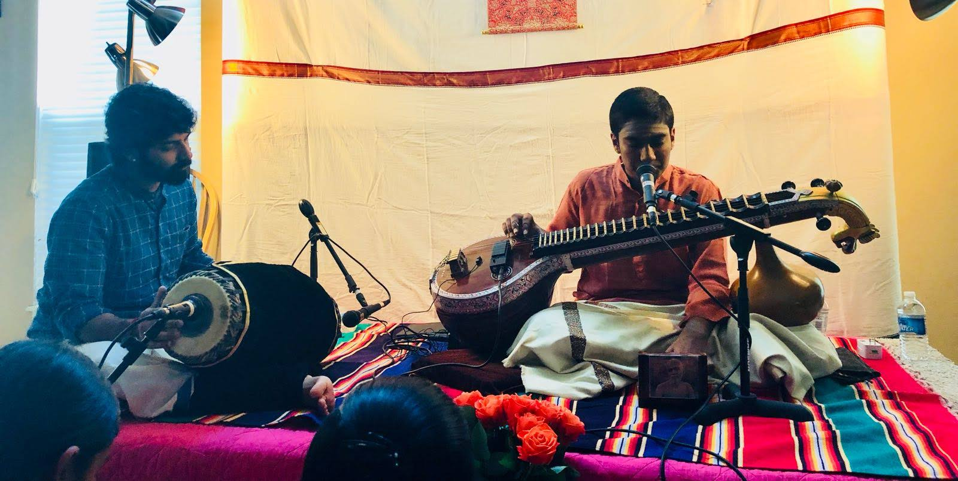
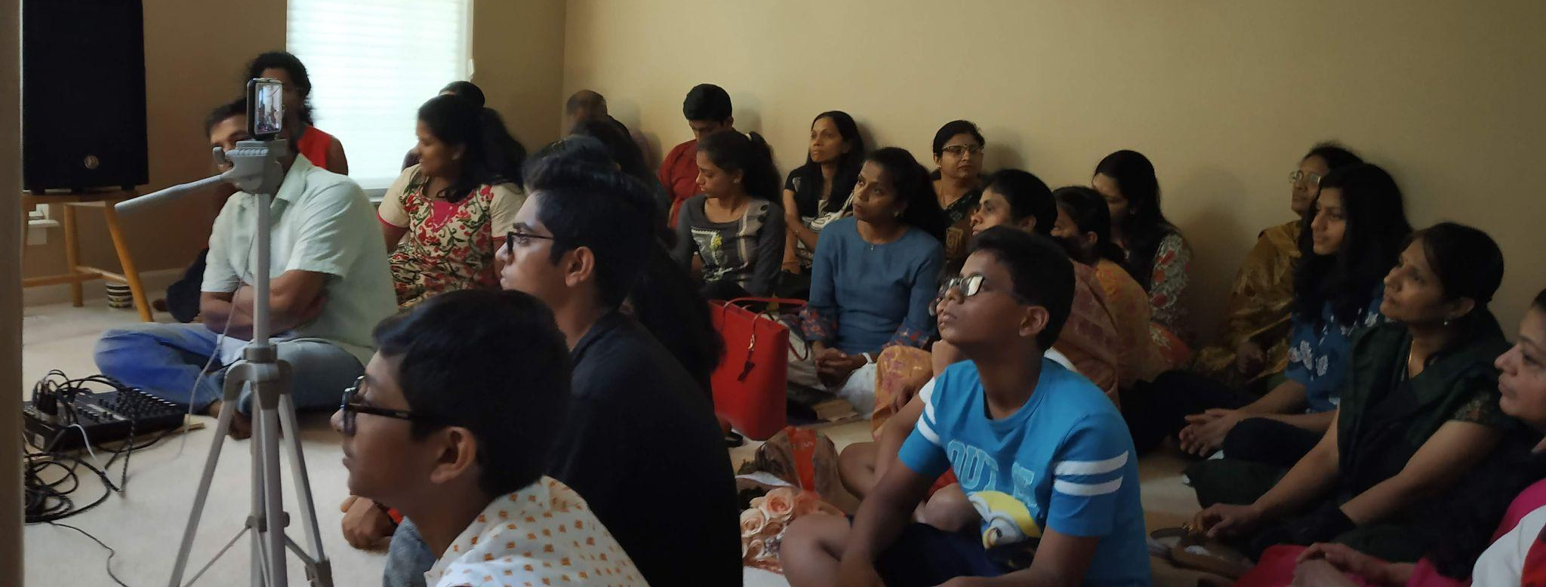
Organisation Name:
Location: Milwaukee
Date: 28/5/18

Slide 21
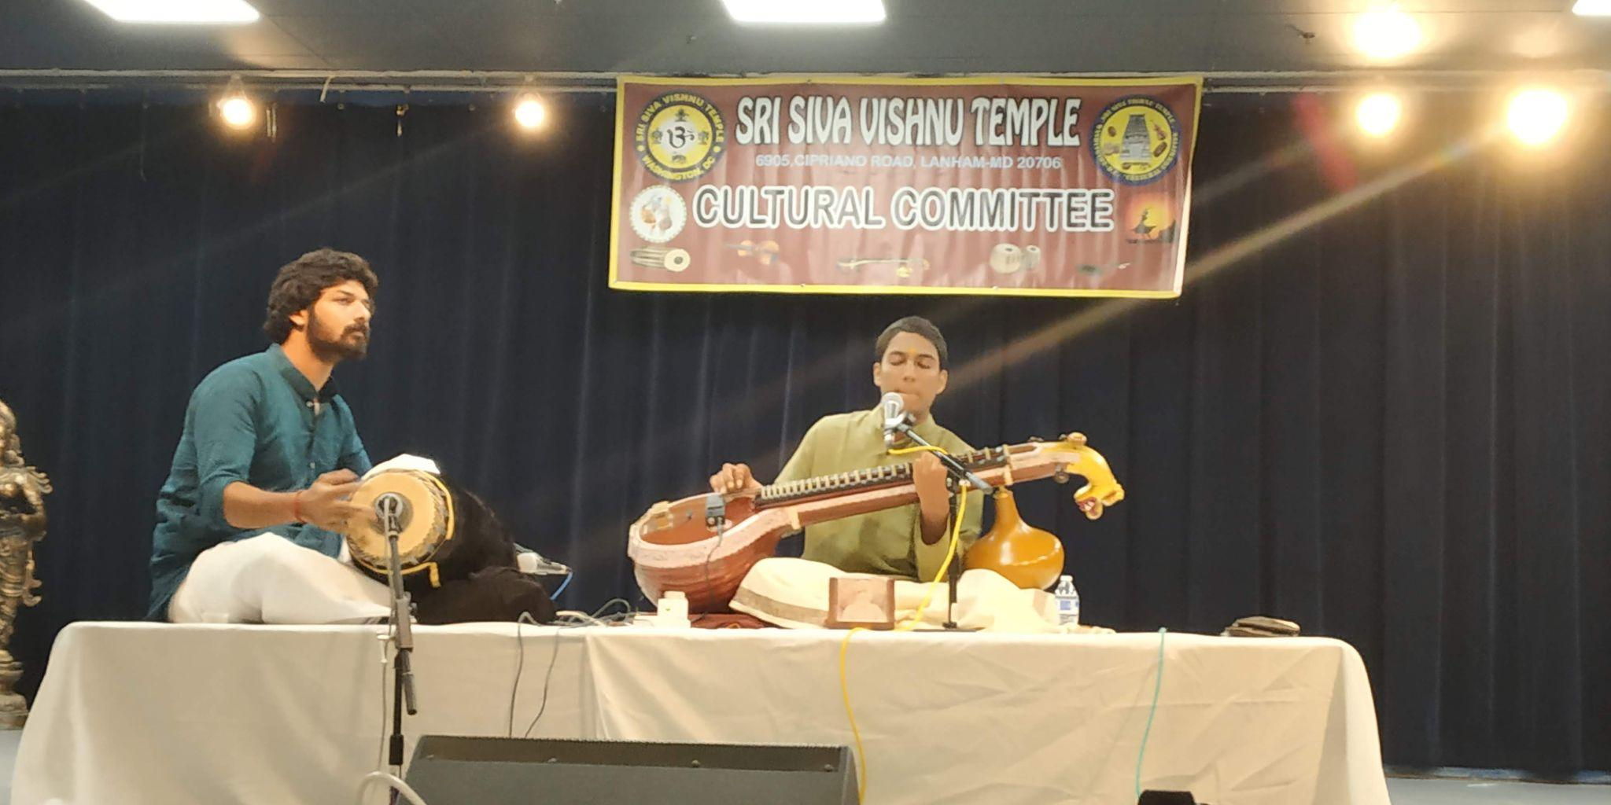
Organisation Name: SSVT Cultural ccommittee
Location: Washington DC
Date: 29/5/18

Slide 22
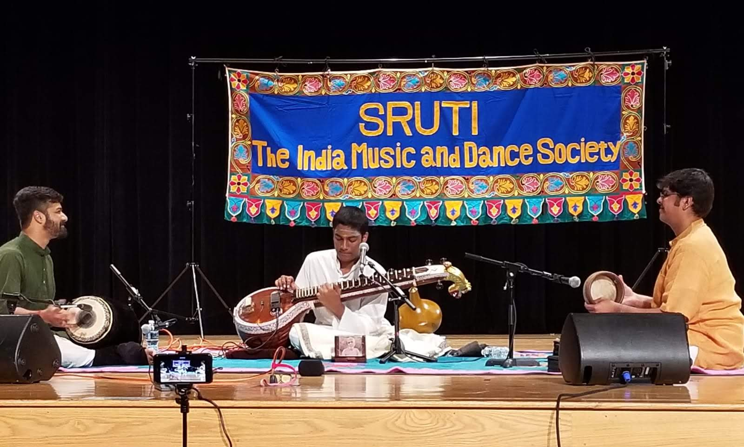
Organisation Name: Sruti - The India Music and Dance Society
Location: Philadelphia
Date: 2/6/18

Slide 23
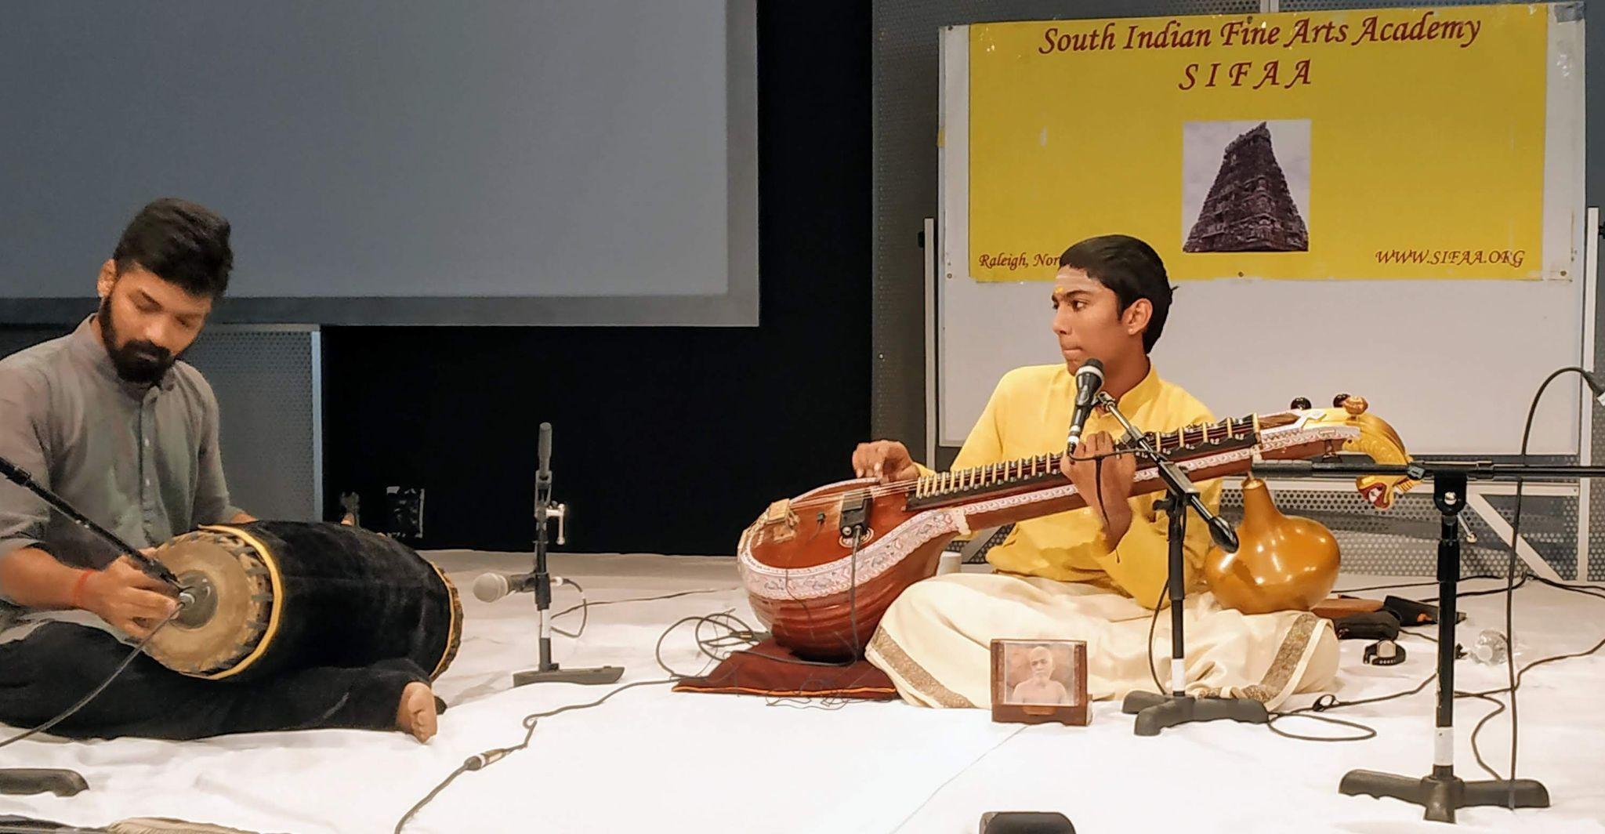
Organisation Name: SIFAA
Location: Raleigh
Date: 3/6/18

Slide 24
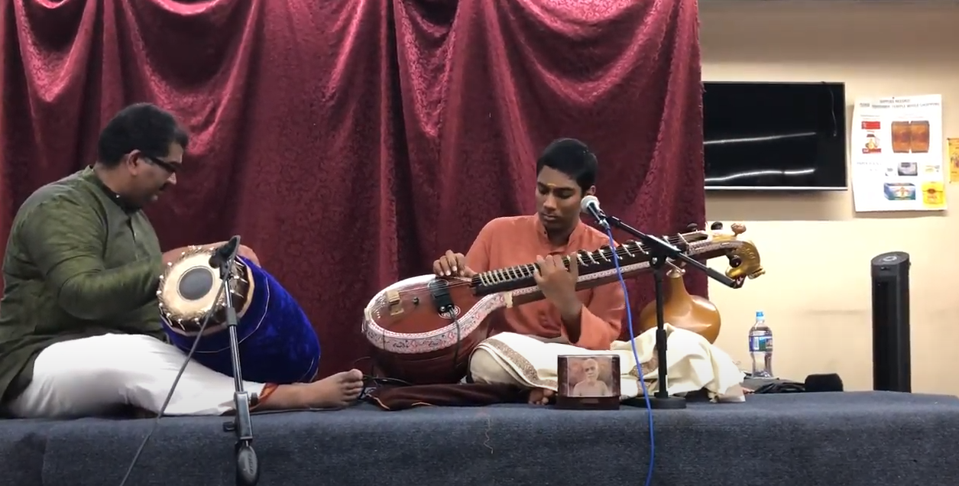
Organisation Name:
Location: Atlanta
Date: 4//6/18

